Slide 1
NLP – Language Processing
Using – RNN-LSTM

Slide 2
NLP Text Processing & Representation Techniques
Label Encoding
Ordinal Encoding
One Hot Encoding
Tokenization
Stop Words
Stemming
Lemmatisation
Vectorization(BOW/TF-IDF)
ML Classification Models

Slide 3
Classification models
Logistic Regression
Decision Tree
Random Forest
Gradient Boosting (GBM / XGBoost / LightGBM)
Support Vector Machine (SVM)
K-Nearest Neighbors (KNN)
Naive Bayes
Voting / Stacking Classifier

Slide 4
BOW / TF-IDF — Pros
Simple & Fast
Easy to implement, low computational cost, works well for traditional ML.
Great for Linear Models
Models like Logistic Regression, SVM perform strongly on these features.
No Training Required
Purely statistical representation; no training time like deep learning.
Works Well on Small Datasets
When data is limited, sparse vector models can outperform deep networks.
Interpretable
Each feature corresponds to a word → easier to analyze importance.

Slide 5
BOW / TF-IDF — Cons
No Word Order
“Dog bites man” and “Man bites dog” look identical → loses meaning.
No Context Understanding
Ignores semantics, sarcasm, negations (“not good” ≠ “good”).
Very High Dimensional
Vocabulary grows → vectors become sparse and computationally heavy.
Cannot Handle Out-of-Vocabulary Words
New/unseen words are lost.
Fails for Long Sentences / Summaries
Only counts tokens; cannot model sentence structure, meaning, or relationships.

Slide 6
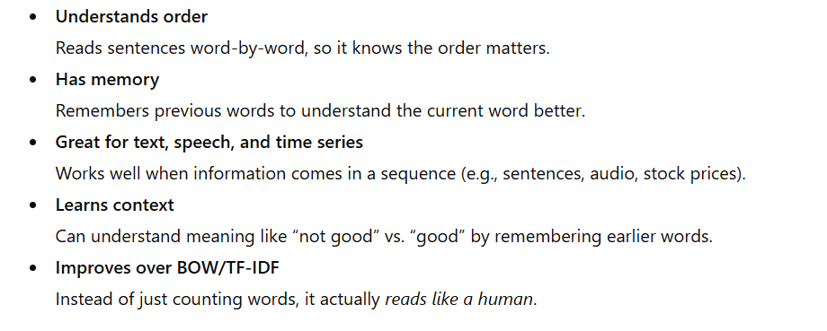
RNN (Recurrent Neural Network)
An RNN is a neural network designed to understand sequences, meaning it reads information step-by-step and remembers what came before.

Slide 7
NLP Tasks
Text Classification
Sentiment Analysis
Keyword Extraction
Text Summarization (Extractive)
Language Detection
Word Embeddings
Similarity Matching

Slide 8
Every RNN project needs three essentials
Every RNN project needs three essentials:
Data – the text or sequence you want the model to learn from
Model – the RNN/LSTM/GRU architecture that processes sequences
Training – the learning process using epochs, loss, and optimization
These three together allow the network to learn patterns, context, and sequence relationships.

Slide 9
Data (Training + Validation)
Collect raw text or sequential data.
Clean & preprocess (tokenize, remove noise, pad sequences).
Convert words to numeric vectors (Embeddings).
Split into:
  Training Data (70–80%) → model learns from this
  Validation Data (10–20%) → checks performance during training
Ensures the RNN learns patterns without overfitting

Slide 10
Model (RNN / LSTM / GRU)
Select the RNN type based on complexity:
  Simple RNN → basic memory
  LSTM → long-term memory
  GRU → faster, efficient memory
Typical architecture:
  Embedding Layer → converts words into dense vectors
  RNN/LSTM/GRU Layer → reads sequence step-by-step
  Dense Output Layer → classification or prediction
Define sequence length, number of units, dropout, etc.

Slide 11
Training (Epochs + Optimizer)
Epochs
  One full pass over the training data
  More epochs → better learning (up to a limit)
Loss Function
  Measures how wrong the model is
  Common: cross-entropy for classification
Optimizer
  Adjusts model weights to reduce loss
  Popular: Adam, RMSprop, SGD
Validation during training
  Helps tune hyperparameters
  Prevents overfitting using early stopping

Slide 12
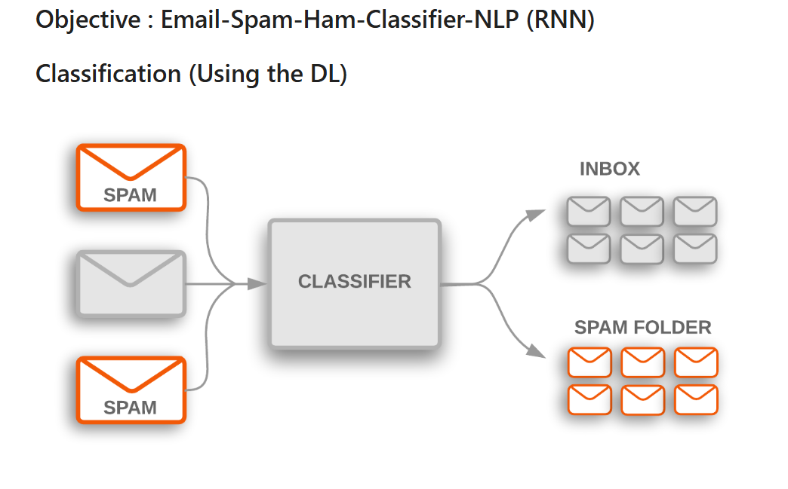
https://github.com/alexvatti/DL-Text-Classify/blob/main/Email-Spam-Classification/RNN_Emails_Spam_Classification.ipynb

Slide 13
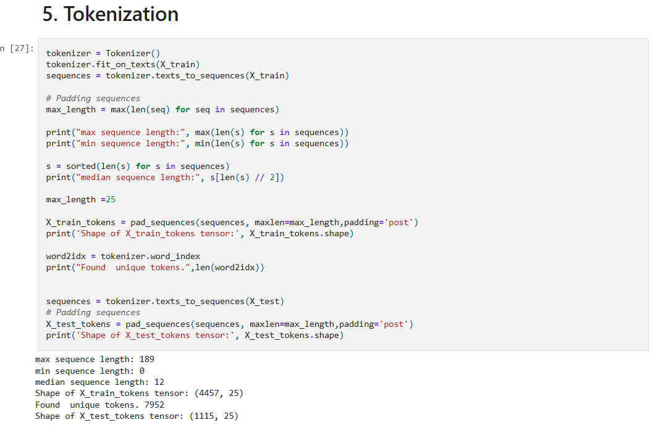
https://github.com/alexvatti/DL-Text-Classify/blob/main/Email-Spam-Classification/RNN_Emails_Spam_Classification.ipynb

Slide 14
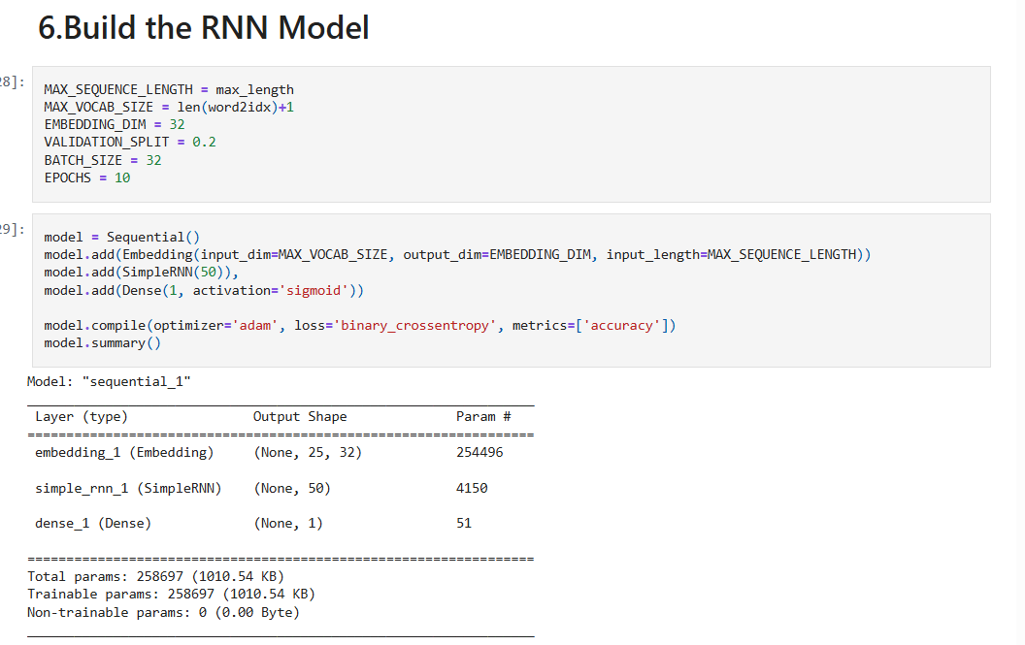
https://github.com/alexvatti/DL-Text-Classify/blob/main/Email-Spam-Classification/RNN_Emails_Spam_Classification.ipynb

Slide 15
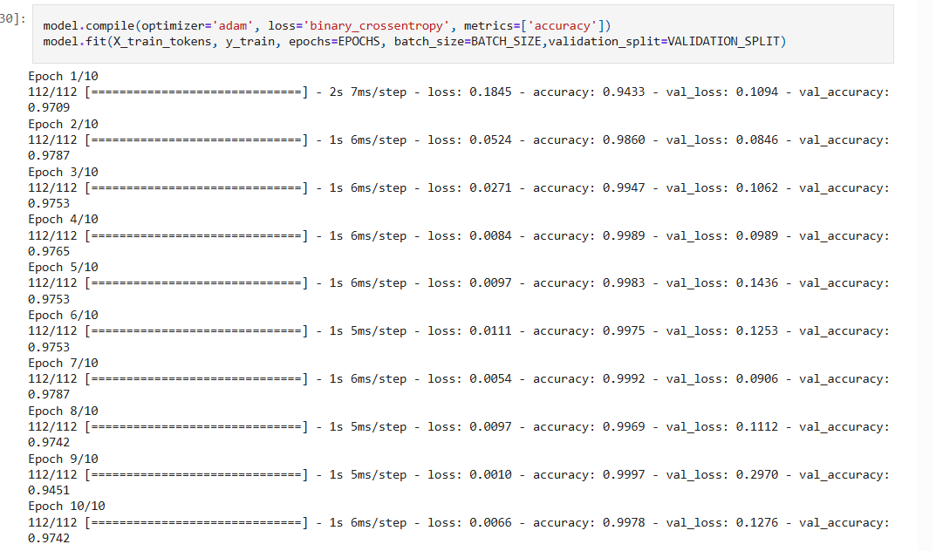










https://github.com/alexvatti/DL-Text-Classify/blob/main/Email-Spam-Classification/RNN_Emails_Spam_Classification.ipynb

Slide 16
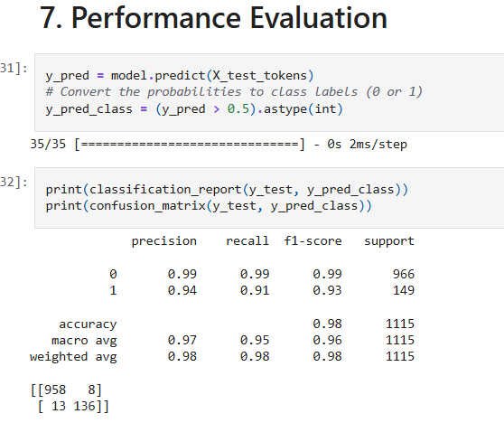
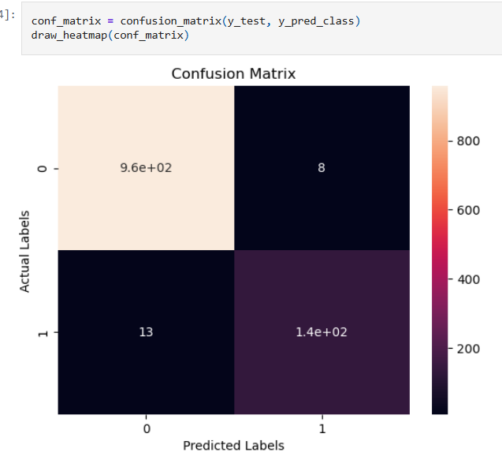
https://github.com/alexvatti/DL-Text-Classify/blob/main/Email-Spam-Classification/RNN_Emails_Spam_Classification.ipynb

Slide 17
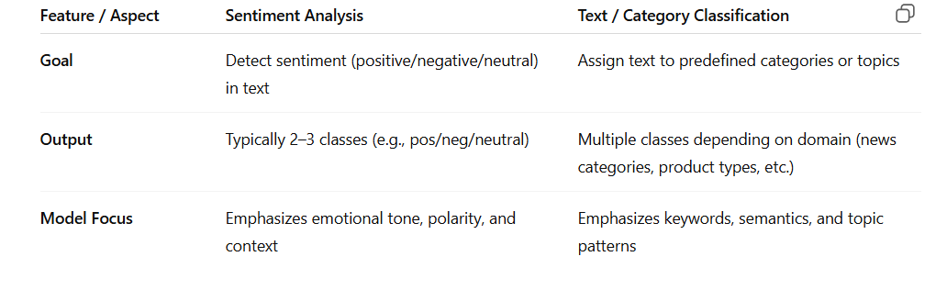
Sentiment Analysis Vs Text/Category Classification

